Slide 1
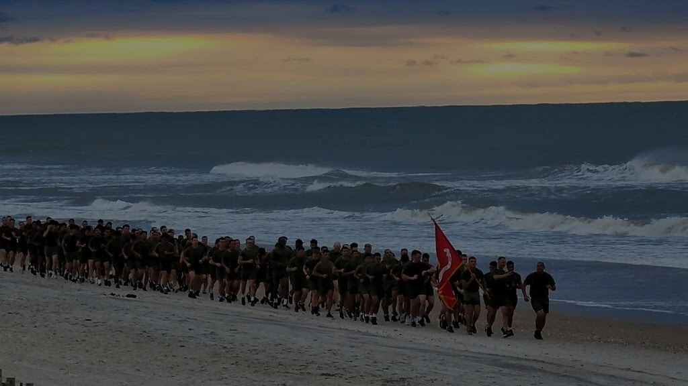
20-MINUTE TRAINING MODULE
RESILIENCE IS
ROOM TO MANEUVER.
A short introduction to Tactical Resilience and Adaptive Cognitive Maneuver
Notice change. Create options. Adapt with purpose.
Designed to supplement—not replace—UMAPIT, OSCAR, leader development, or professional care.
TRACM // TACTICAL RESILIENCE & ADAPTIVE COGNITIVE MANEUVER
01

Slide 2
WHY THIS MATTERS
Friction narrows the field.
Under pressure, the first danger is often not weakness. It is a shrinking set of perceived options.
→
→
→
SURPRISE
ONE STORY
ONE RESPONSE
LESS AGENCY
TRACM trains the counter-move:
VARIETY
RAPIDITY
HARMONY
INITIATIVE
see more
adjust sooner
stay connected
act with ownership
Moral authority creates the trust that lets these qualities emerge under pressure.
TRACM // TACTICAL RESILIENCE & ADAPTIVE COGNITIVE MANEUVER
02

Slide 3
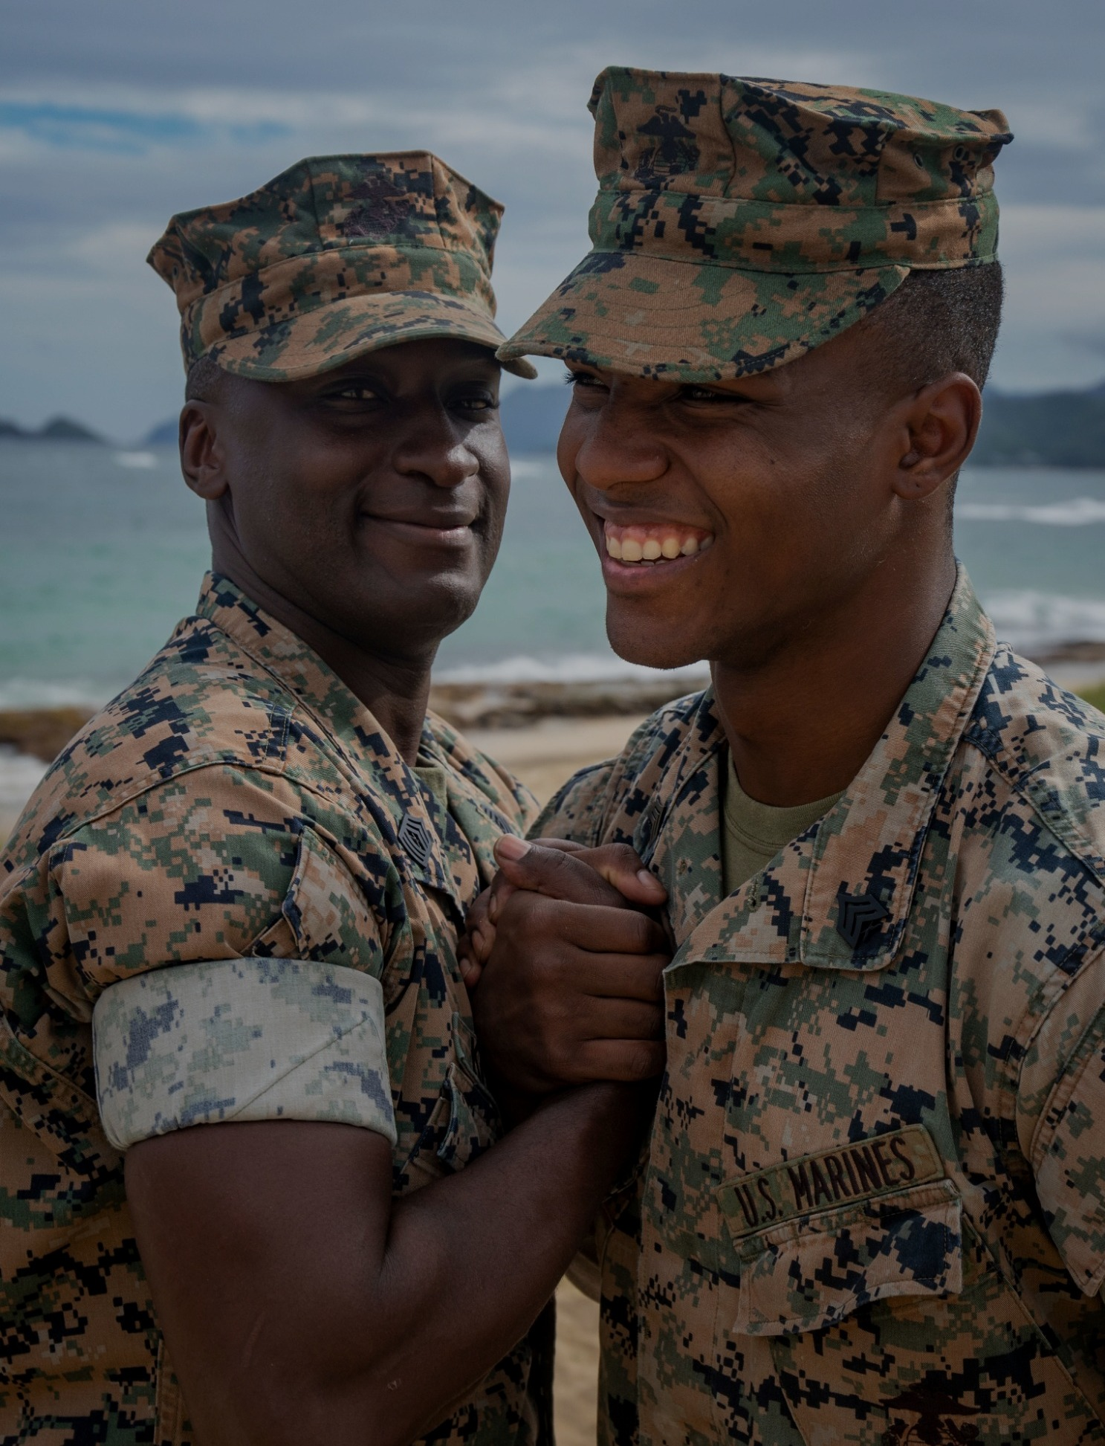
DOCTRINE OF RESILIENCE
From endurance to adaptation.
Old questions
“How do I endure this?” “Can I handle this?”
TRACM question
“What can I do now?” “How do I retain room to maneuver?”
Resilience is the ability to adapt so that conditions are better suited to achieve your desired result when confronted with adversity.
It is the practiced ability to recognize stress for what it is, preserve your options, remain connected, and make a useful adjustment before agency collapses.
TRACM // TACTICAL RESILIENCE & ADAPTIVE COGNITIVE MANEUVER
03

Slide 4
THE ADAPTIVE QUALITIES
Four ways to regain maneuver space.
VARIETY
RAPIDITY
Generate more than one interpretation, option, or response.
Move from recognition to useful action before uncertainty
becomes paralysis.
HARMONY
INITIATIVE
Keep people, purpose, strengths, resources, and reality connected.
Act with ownership inside shared purpose and intent.
THROUGH MORAL AUTHORITY
Trust makes adaptation safer.
TRACM // TACTICAL RESILIENCE & ADAPTIVE COGNITIVE MANEUVER
04

Slide 5
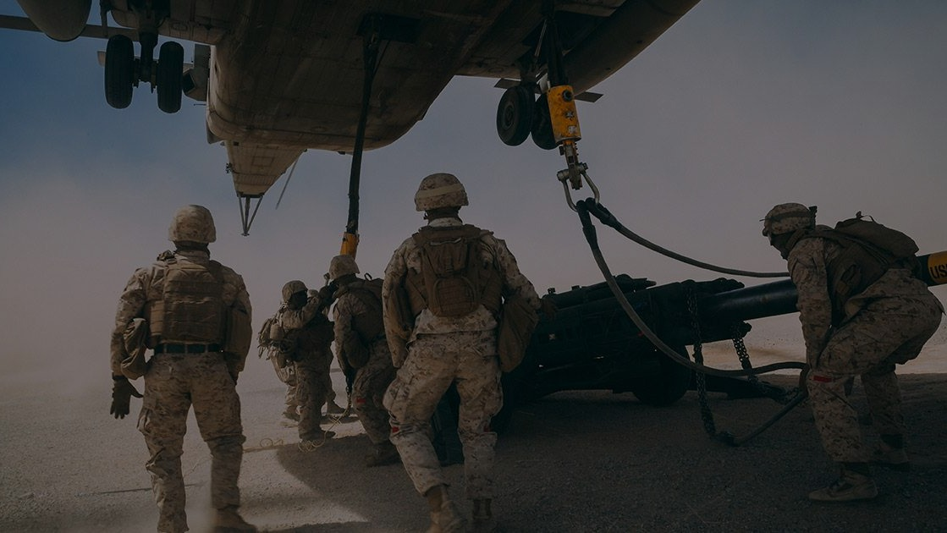
BUDDY DRILL // 3 MINUTES
WHEN THE PLAN BREAKS
Think of a recent moment when something changed and your first plan stopped working.
1 What surprised you?
2 What story did you immediately tell yourself?
3 What were two other possible explanations or actions?
4 Who or what could have helped you see more clearly?
5 What would you do sooner next time?
PAIR UP. 90 seconds each. Listen—don’t solve.
TRACM // TACTICAL RESILIENCE & ADAPTIVE COGNITIVE MANEUVER
05

Slide 6
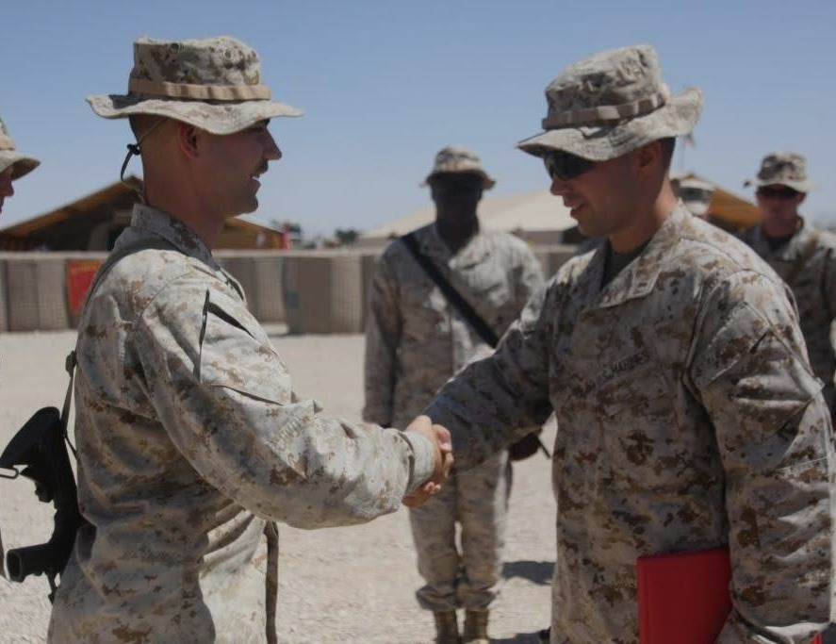
A LEADER'S ROLE
Coach the Marine to think—not just comply.
ASK
Start with curiosity.
LISTEN
Hear facts, energy, contradictions.
EXPAND
Create more than one option.
ALIGN
Reconnect mission, values, strengths.
ACT
Return ownership of the next move.
The conversation itself either builds—or spends—moral authority.
TRACM // TACTICAL RESILIENCE & ADAPTIVE COGNITIVE MANEUVER
06

Slide 7
LEADER QUESTIONS
Questions that create room to maneuver.
VARIETY
RAPIDITY
HARMONY
INITIATIVE
What else could be true?
What changed?
Who do you need?
What part belongs to you?
Give me three ways forward.
What matters now?
What strength can you lean on?
What can you influence?
Whose perspective are we missing?
What is the smallest useful move?
What does the team need from you?
What will you do next?
Better questions widen the field before the leader narrows it with an answer.
TRACM // TACTICAL RESILIENCE & ADAPTIVE COGNITIVE MANEUVER
07

Slide 8
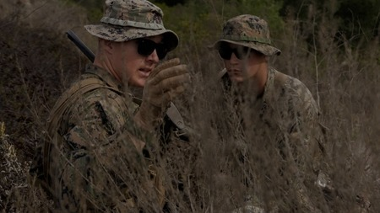
TABLE EXERCISE // 5 MINUTES
PLAY THE NEXT MOVE.
Use one TRACM scenario card.
1
2
3
4
5
6
READ
GENERATE
DECIDE
INJECT
ADAPT
AAR
Situation only
3 options
Commit
New information
Change if needed
What changed?
Standard: change your mind for a good reason.
The objective is not the 'right answer.' It is better judgment under changing conditions.
TRACM // TACTICAL RESILIENCE & ADAPTIVE COGNITIVE MANEUVER
08

Slide 9
SHAPE
What leaders do before, during, and after friction.
S
SHAPE
Build trust, skill, shared understanding, and room for honest questions.
H
HEAR
Seek weak signals, dissent, rising load, and hidden expertise.
A
ADAPT
Change plan, pace, roles, support, or method as conditions change.
P
PROTECT
Reduce avoidable harm and connect real risk with qualified support.
E
ENERGIZE
Restore capacity through purpose, strengths, rest, connection, and participation.
ENERGIZE is continuous—not a final step.
TRACM // TACTICAL RESILIENCE & ADAPTIVE COGNITIVE MANEUVER
09

Slide 10

FEEDBACK
Resilience grows through repetitions—not slogans.
After action:
•
What did we notice—and miss?
•
What assumption drove the first move?
•
What new information changed the picture?
•
Where did we preserve or lose agency?
•
What will we rehearse next?
FEEDBACK → UPDATE → REPEAT
TRACM // TACTICAL RESILIENCE & ADAPTIVE COGNITIVE MANEUVER
10

Slide 11
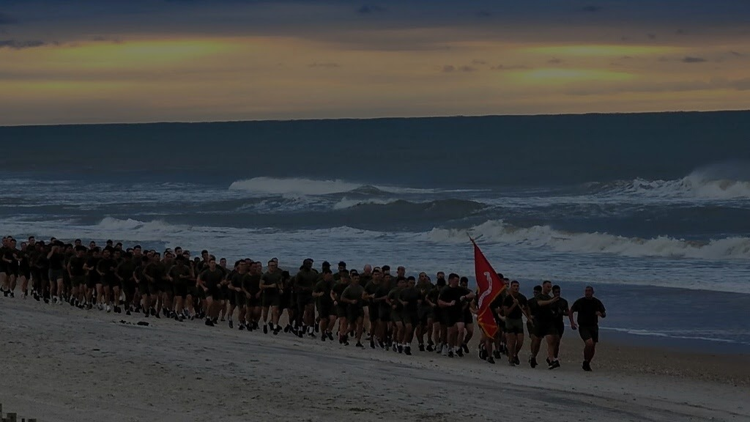
THE FUTURE OF RESILIENCE TRAINING
Practice adaptation
before the bad day.
Not another annual brief.
A repeatable training habit:
SCENARIOS • LEADER QUESTIONS • REHEARSALS • FEEDBACK
TRACM gives Marines a language and a practice for retaining room to maneuver when friction arrives.
VARIETY
RAPIDITY
HARMONY
INITIATIVE
TRACM // TACTICAL RESILIENCE & ADAPTIVE COGNITIVE MANEUVER
11

Slide 12
FACILITATOR
20-minute run of show.
Use this slide as the instructor's quick reference; hide it when presenting if desired.
0:00–2:00
OPEN
Slides 1–2
Friction narrows options. TRACM trains room to maneuver.
2:00–5:00
TEACH
Slides 3–4
Define adaptation + Variety, Rapidity, Harmony, Initiative.
5:00–8:00
BUDDY DRILL
Slide 5
90 seconds each; listen, do not solve.
8:00–11:00
COACH
Slides 6–7
Introduce leader questions and moral authority.
11:00–16:00
SCENARIO
Slide 8
Use a TRACM scenario card; reveal injects sequentially.
16:00–19:00
SHAPE + AAR
Slides 9–10
Connect leader behavior to feedback and repetition.
19:00–20:00
CLOSE
Slide 11
Practice adaptation before the bad day.
Safety note: this is leadership and judgment training, not diagnosis or treatment. Real safety concerns require appropriate command/emergency and qualified support pathways.
TRACM // FACILITATOR REFERENCE
12

